Slide 1
E-R Model
ER Model is used to model the logical view of the database system.
It uses entities, attributes, and relationships to represent data and its associations.

Slide 2
Components of E-R Model
Entity - An Entity may be an object with a physical existence - a particular person, car, house, or employee - or it may be an object with a conceptual existence - a company, a job, or a university course.
Entity is represented by an rectangle.

Slide 3
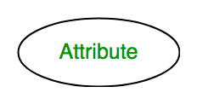
2. Attributes
Attributes are the properties which define the entity type.
example, Roll_No, Name, DOB, Age, Address, Mobile_No are the attributes which defines entity type Student.
In ER diagram, attribute is represented by an oval.

Slide 4
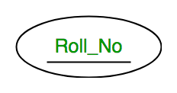
Types of Attributes
Key Attribute -
The attribute which uniquely identifies each entity in the entity set is called key attribute.
For example, Roll_No will be unique for each student.
In ER diagram, key attribute is represented by an oval with underlying lines.

Slide 5
b . Composite Attribute
An attribute composed of many other attribute is called as composite attribute.
For example, Address attribute of student Entity type consists of Street, City, State, and Country.
In ER diagram, composite attribute is represented by an oval comprising of ovals.

Slide 6
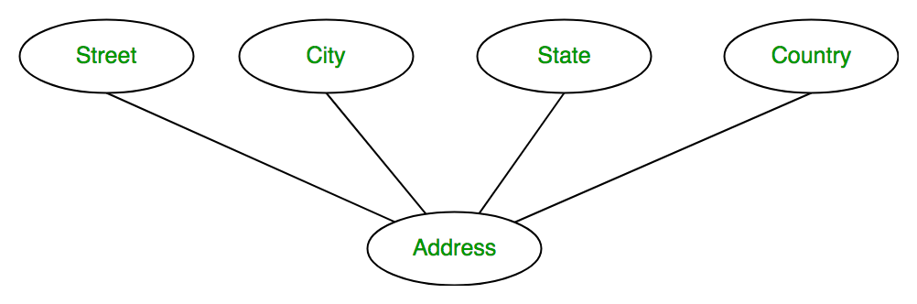
Composite Attribute
Example

Slide 7
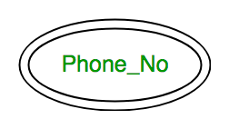
c . Multivalued Attribute
An attribute consisting more than one value for a given entity.
For example, Phone_No (can be more than one for a given student).
In ER diagram, multivalued attribute is represented by double oval.

Slide 8
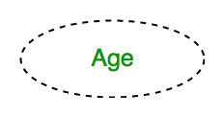
d. Derived Attribute
An attribute which can be derived from other attributes of the entity type is known as derived attribute.
e.g.; Age (can be derived from DOB). In ER diagram, derived attribute is represented by dashed oval.

Slide 9
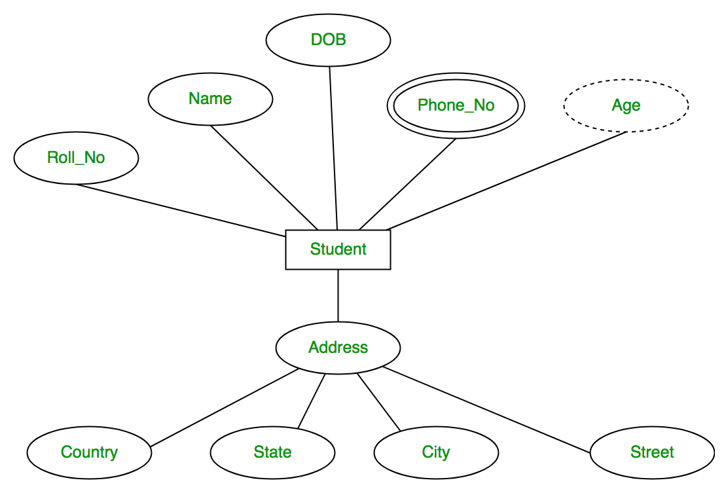
The complete entity type Student with its attributes can be represented as

Slide 10
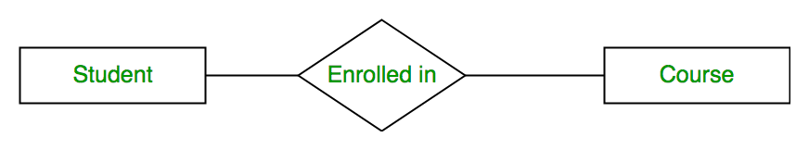
3. Relationship Sets
Relationship : A relationship is the association among several entities. It connects different entities through a meaningful relation.
For example : ‘Enrolled in’ is a relationship type that exists between entity type Student and Course. In ER diagram, relationship type is represented by a diamond and connecting the entities with lines.

Slide 11
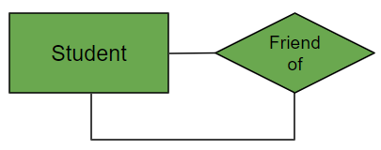
Degree of a relationship set:
The number of different entity sets participating in a relationship set is called as degree of a relationship set.
a. Unary Relationship
When there is only ONE entity set participating in a relation, the relationship is called as unary relationship.
Example 1: A student is a friend of itself.

Slide 12
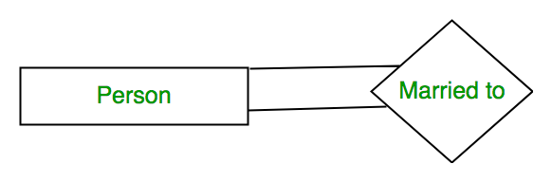
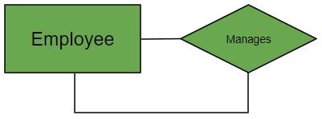
Example 2: A person is married to a person.

Slide 13

b. Binary Relationship
When there are TWO entities set participating in a relation, the relationship is called as binary relationship.
For example, Student is enrolled in Course.

Slide 14


Example 2: A supplier supplies item.
Example 3: A Professor teaches subject.

Slide 15
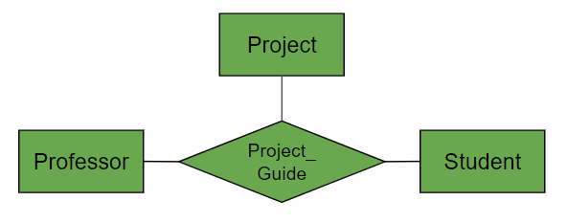
c. n-ary Relationship
When there are n entities set participating in a relation, the relationship is called as n-ary relationship.
Example: A Professor, student and Project is related to a Project_Guide.

Slide 16
Cardinality
The number of times an entity of an entity set participates in a relationship set is known as cardinality.
Cardinality can be of different types:
One to One - When each entity in each entity set can take part only once in the relationship, the cardinality is one to one.
Example 1: Let us assume that a driver can drive one car and a car can be driven by the same driver. So the relationship will be one to one.

Slide 17
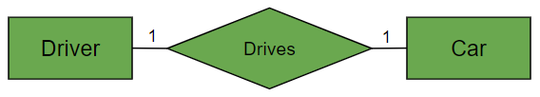

Eg
Example 2: A person can have only one Aadhar card and one Aadhar card can belong to only one person.

Slide 18
2. One to Many
When entities in one entity set can take part only once in the relationship set and entities in other entity sets can take part more than once in the relationship set, cardinalities is one to many.
Many to one also come under this category.

Slide 19
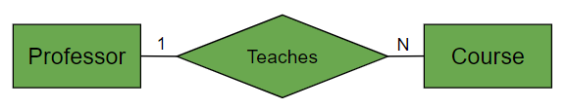
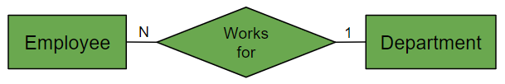
Example 1: A professor teaching many courses
Example 2: Many employees working for one department.

Slide 20

3. Many to many
When entities in all entity sets can take part more than once in the relationship cardinality is many to many.
Example 1: Any number of student can take any number of subjects.

Slide 21

Participation Constraints
Participation Constraint is applied on the entity participating in the relationship set.
Total Participation - Each entity in the entity set must participate in the relationship.
Example 1: Each employee must join a department.

Slide 22
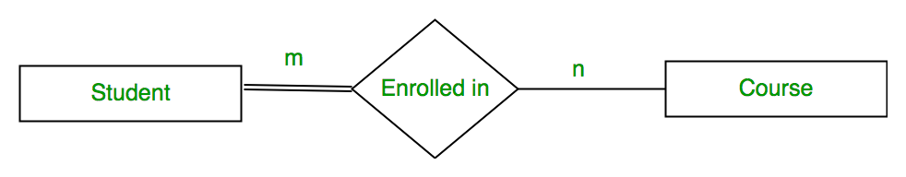
2. Partial Participation -
The entity in the entity set may or may NOT participate in the relationship. If some courses are not enrolled by any of the student, the participation of course will be partial.
The diagram depicts the ‘Enrolled in’ relationship set with Student Entity set having total participation and Course Entity set having partial participation.

Slide 23
KEYS
Keys in a Database Management System (DBMS) are attributes or sets of attributes that help to uniquely identify a tuple (row) within a relation (table).
The attributes which are used as key are known as key attributes. Rest of all are known as Non-key attributes.

Slide 24
Types Of Keys
Super Keys :
A super key is a set of collection of one or more than one attributes that can identify data uniquely.
Any set of attributes that allows us to identify unique rows (tuples) in a given relationship are known as superkeys.

Slide 25
Employee
Table
Reg No | ID | Name | Salary | Age
S1D | 1 | Monu | 20000 | 23
A25 | 2 | Shivam | 25000 | 25
3B6 | 3 | Anuj | 25000 | 23
5V9 | 4 | Ankit | 23000 | 20
7M5 | 5 | Monu | 22000 | 24

Slide 26
In entity set Employee, Super Keys are
(a) (ID, Name, Salary, Reg. No. , age)
(b) (ID)
(c) (Reg. No.)
All combinations can identify data uniquely.

Slide 27
Candidate Key :
The minimal super key is known as candidate key. Consider a super key and then take all of its proper subsets. If no one of the proper subsets are super key. Then this super key is taken as candidate key.
Must contain unique values.
Ex. ID and Reg. No. are candidate key.

Slide 28
Primary Key :
There can be more than one candidate key in relation out of which one and the most suitable must be chosen as the primary key.
Must contain unique values.
Cannot contain NULL values.
Ex. In entity set Employee, either Reg. No. is primary key or ID is primary key.

Slide 29
Alternate Keys :
All the candidate keys other than Primary Key are known as Alternate Keys.
Ex. If you take ID as Primary Key. Then, Reg. No. is an alternate key

Slide 30
Secondary Key :
An attribute or set of attributes which doesn’t identify data uniquely but identifies a group of data is known as secondary key.
Ex. Name, Salary and Age are all secondary keys.

Slide 31
Foreign Key :
A foreign key is an attribute or a set of attributes in one table that references the primary key or a unique key in another table. It is used to establish and enforce a link between the data in the two tables.
To ensure referential integrity between tables.

Slide 32
Example :
Employee
Reg No. | ID | Name | Salary | Age | Dept-ID
S1D | 1 | Monu | 22000 | 24 | 10
A2C | 2 | Anuj | 23000 | 23 | 20
F3S | 3 | Ankit | 25000 | 26 | 30
Z5X | 4 | Monu | 23000 | 20 | 20
V7N | 5 | Sonu | 20000 | 24 | 10

Slide 33
Department
Table
Dept-ID | Dept_Name
10 | Sales
20 | Development
30 | Marketing

Slide 34
Ex. Dept_ID: This is an attribute in entity set Employee and also a primary key in entity set Department. Thus, it is a foreign key in Employee.

Slide 35
Consider two tables, Students and Enrollments:
Student Table
Student _Id | Name
1 | Ankit
2 | Vinit
3 | Nitin

Slide 36
Enrollments
Table
Enrollment_ID | Student_ID | Course_ID
101 | 1 | 501
102 | 2 | 502
103 | 1 | 503

Slide 37
Primary Key in Students: student_id
Super Key in Students: {student_id}, {student_id, name}
Foreign Key in Enrollments: student_id (references student_id in Students)
In this example:
student_id in the Students table is a super key because it uniquely identifies each student.
student_id in the Enrollments table is a foreign key because it references the student_id in the Students table.

